Slide 1

Virgin America

Slide 2
Overview
Virgin America is a United-States based airline that was started to provide a low-fare, high quality service for long-haul point-to-point service between major metropolitan cities on the Eastern and West Coast seaboards.
Considering the demand it has in general demography currently, Virgin America has identified this demand and redesigned the website in 2014 that provides a great user-experience along with great services.
Some of the important aspects of this good user-experience are :
Homepage.
Navigation Bar.
Search.
Navigation between Links.
Icons.
Validations.

Slide 3
Homepage
As we say first impression is the last impression and that is what Virgin America believes in. The homepage of the website is very clean and easy to understand and use. By clean I mean that is does not has any advertisements neither there are some complicated functions or offers in the form of big tabs.
All the different links for the offers are very well organized and any important news concerning the airlines is very well displayed on top of the homepage which is a very good UX.

Slide 4
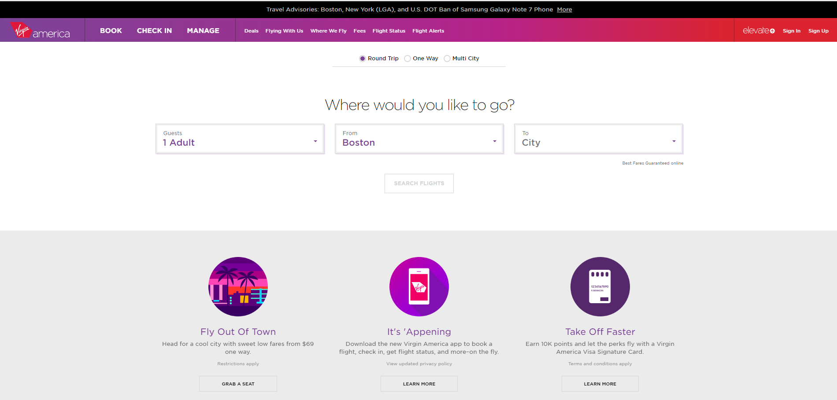

Slide 5
Navigation Bar
As compared to any other website the navigation bar includes a combination of bold and normal letters where the bold letters are some important links such as Book, Manage, Check-In which are more important links as per the user.
Alongside these links there are also some important link to view some of the deals, Fees and also to check flight status. Thus these links being reflected so clearly on the nav bar it is easy for a user to use these links without having to search for them as on other websites.

Slide 6
Search
The search box displays information in a very organized manner asking only important details from users such as number of persons flying, origin, destination and on the click of search flights button there is a very well displayed tabular date format for the user to select the dates of journey.
This kind of date selection is a very good user-experience for the mobile app where being a small screen such big tabs would allow the user to easily select the dates. Thus this feature explains that the defined scope of the website considering the mobile users has been met.
The dates also display the pricing information which helps users to select the lowest fare flight which is also a good UX on part of the users.

Slide 7
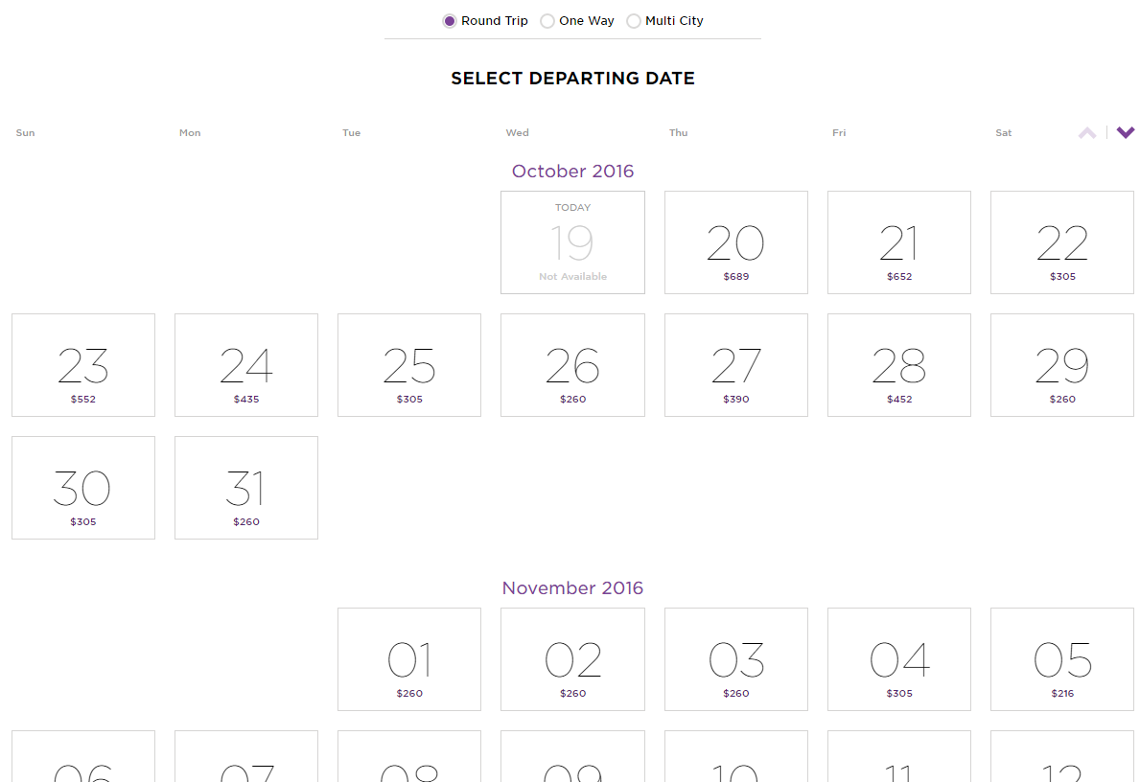

Slide 8
Navigation
The navigation between different functions and links is very smooth with the back button on top of the page that allows a user to easily navigate back to the previous step if he makes an error.
The smoothness of this navigation is mainly because the website has been developed as a single page i.e the whole process of search select dates and review your booking occurs on the same page which allows the user to go back to the previous step just by scrolling up.
Thus there are no buttons for this purpose making the UX even more rich.

Slide 9
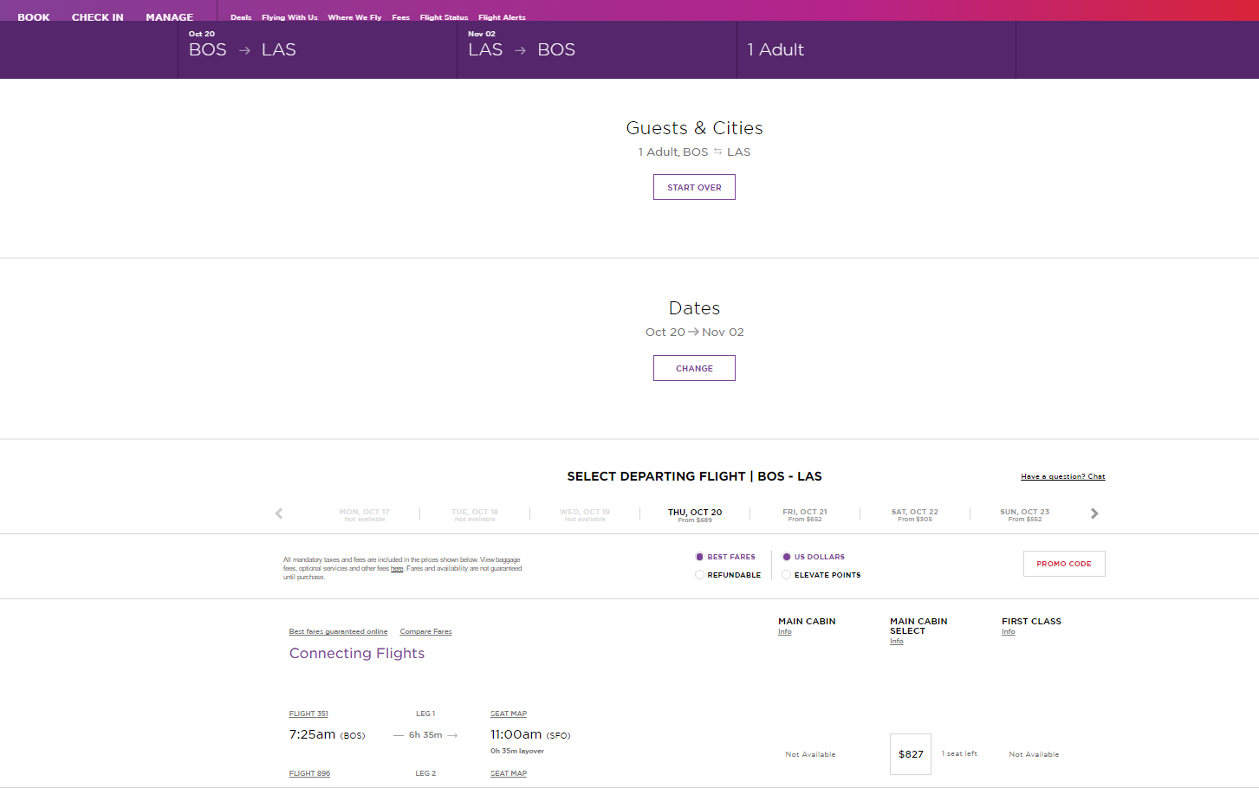

Slide 10
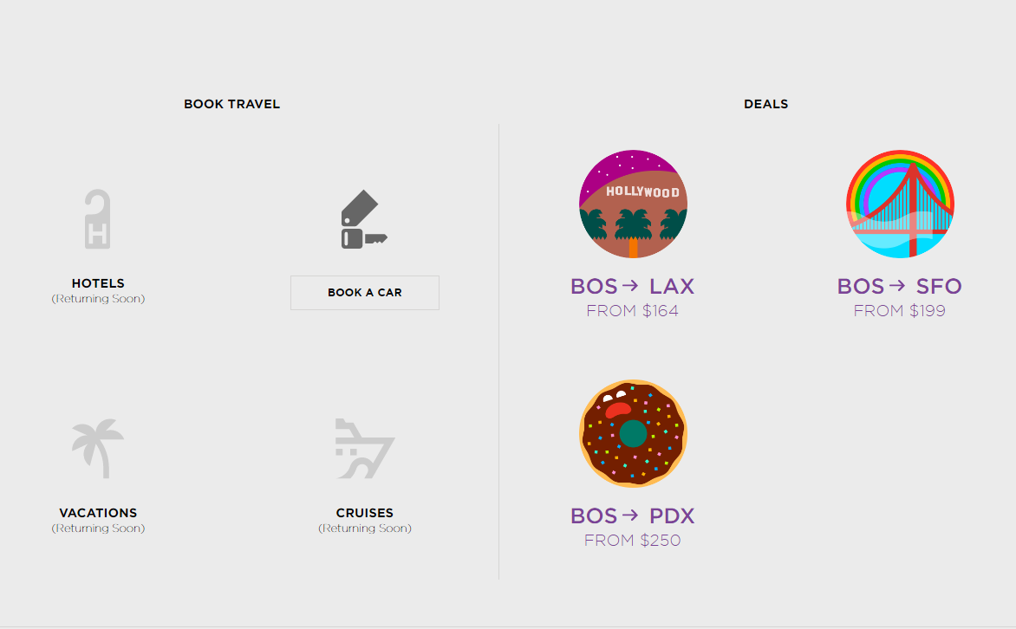
ICONS
Icons are always important to attract users since the reflect the visual appeal which is very important part of creating good UX. Thus the Virgin America website has considered this aspect very seriously.
The Icons for different locations reflect the attractions of that particular location such as Golden Gate for San Francisco. This icons are very appealing to the eye and suits the colour combination of the overall website quite perfectly.

Slide 11
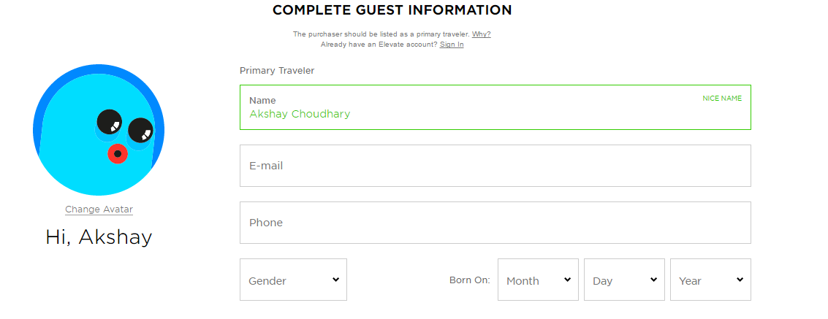
Validations
We know that while booking tickets the user information form is always validated, but the way this website does validation makes it unique among others website.
When a person enters his first name there is an avatar on the left side that says nice name and along with that it asks for full name which is a good feature to implement that takes the User-Experience even more further as compared to other websites.

Slide 12
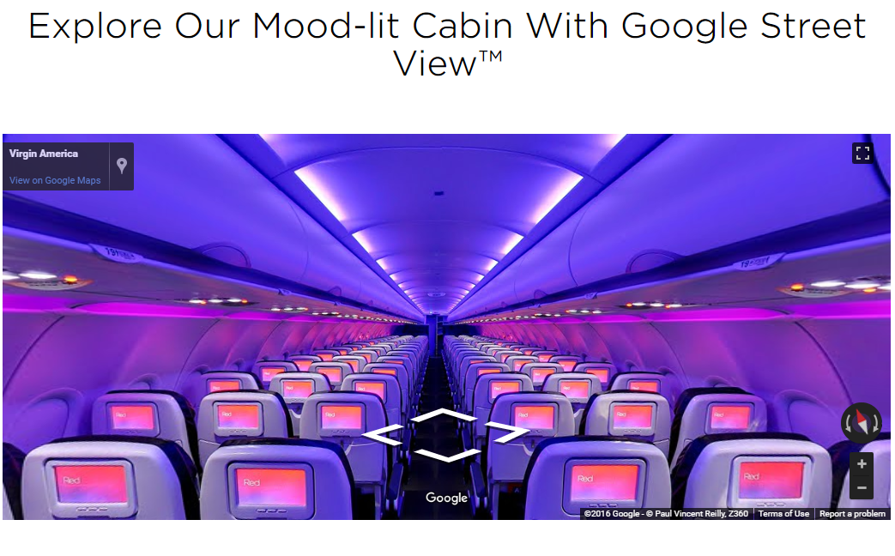
Moonshot
Virgin America allows its customers to have a in-flight experience before they can book the tickets. This experience works the same way as Google Street View works.
This allows passengers to book the seats on their preference with a very good view of the seat before booking. This feature could be considered as a particular moonshot for the website to drag more and more customers to the airlines.

